Slide 1
Pinagem
Sistemas Microcontrolados

Slide 2

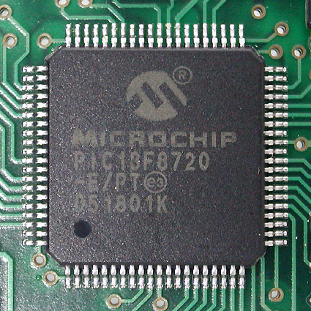
TQFP-pinout ATmega640/1280/2560
Quad Flat Package (QFP)
TQFP (Thin QFP)

Slide 3
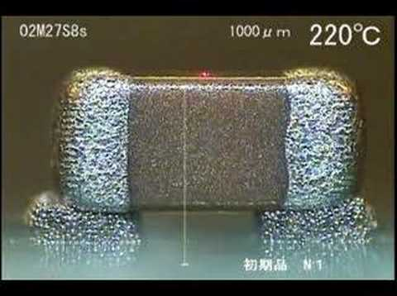
Surface-mount technology (SMT)
https://www.youtube.com/watch?v=o_SwxI2KTys

Slide 4
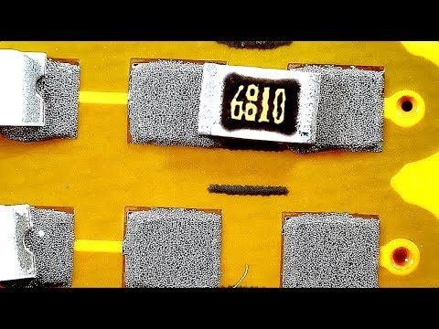
https://www.youtube.com/watch?v=S8qkaTsr2_o
https://www.youtube.com/watch?v=tQHDSXDZYF4

Slide 5
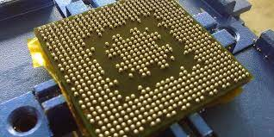
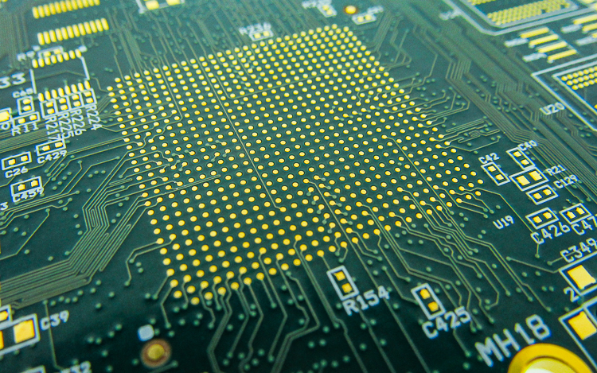
Solda BGA (ball grid array)

Slide 6
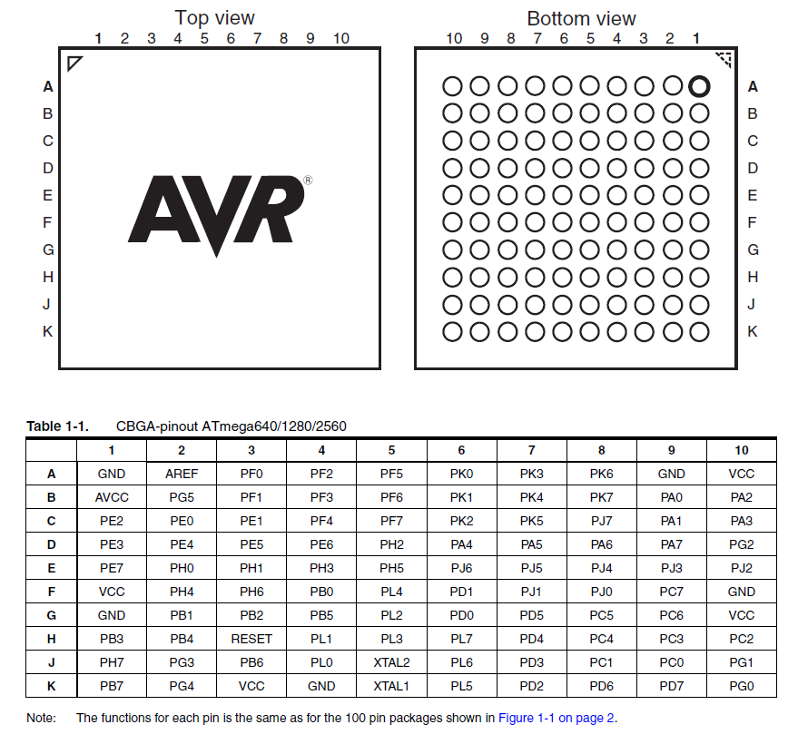

Slide 7
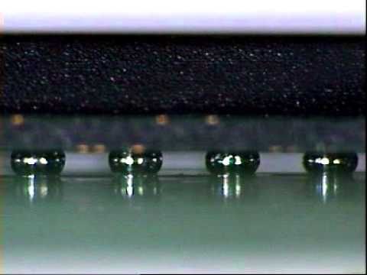
https://www.youtube.com/watch?v=5mWHRakh5Hw

Slide 8
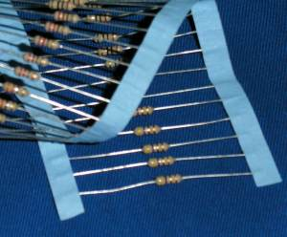
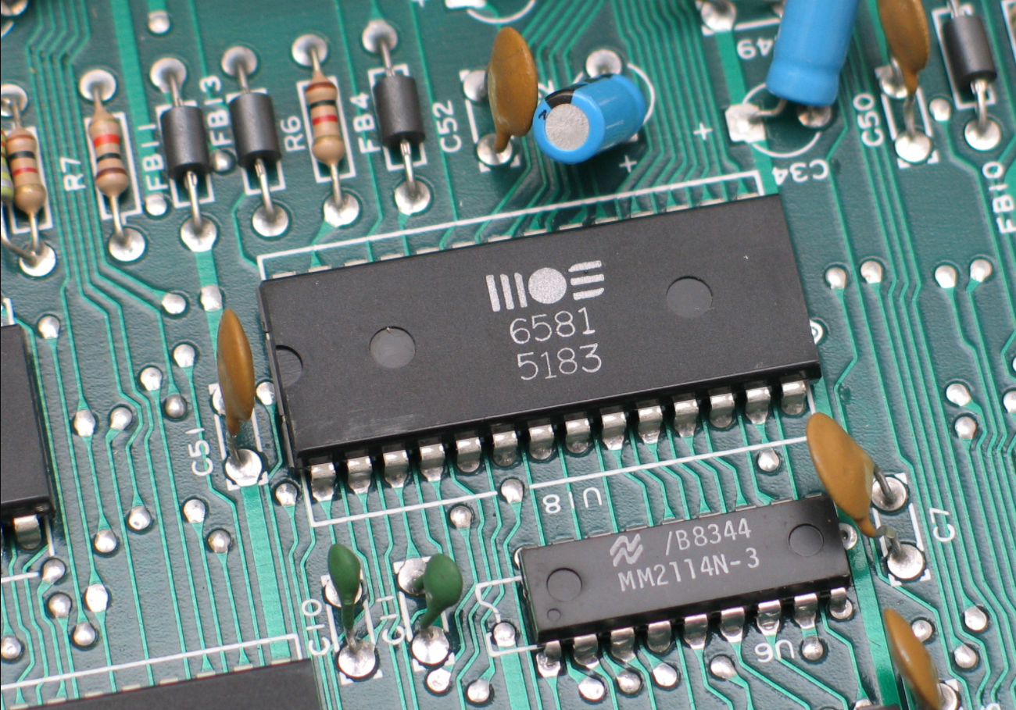
Componente PTH (Plated through-hole)

